Slide 1

Pooled Regression
Felipe Buchbinder

Slide 2

A Pooled regression treats panel data as if it were pooled data

Slide 3
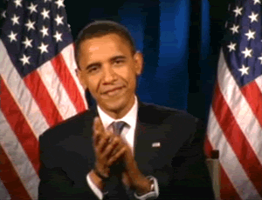

Slide 4

Seriously, what does this mean?

Slide 5
Pooled data : A different sample of entities at each time period
Sample 1
Sample 2
Sample 3

Slide 6
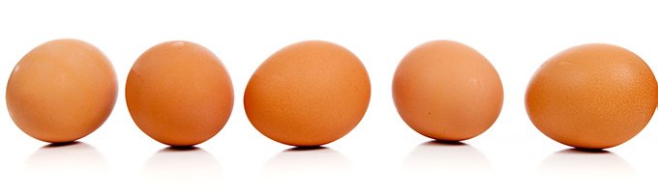
Pooled data is like a time series of cross-sections

Slide 7
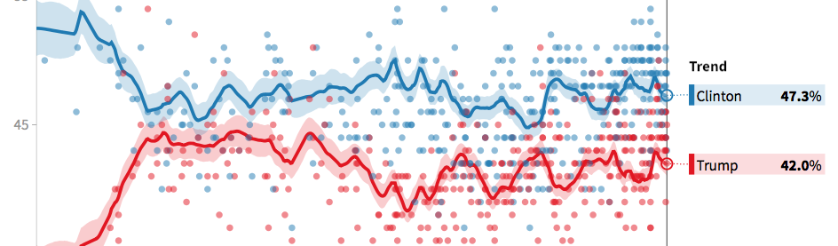
Election polls are an example of pooled data a different group of people is sampled at each time

Slide 8

In pooled regression, just forget you have panel data and run an ordinary linear regression instead

Slide 9
This means we stack all observations and treat them as independent observations

Slide 10

Awesome! Can I do that?

Slide 11
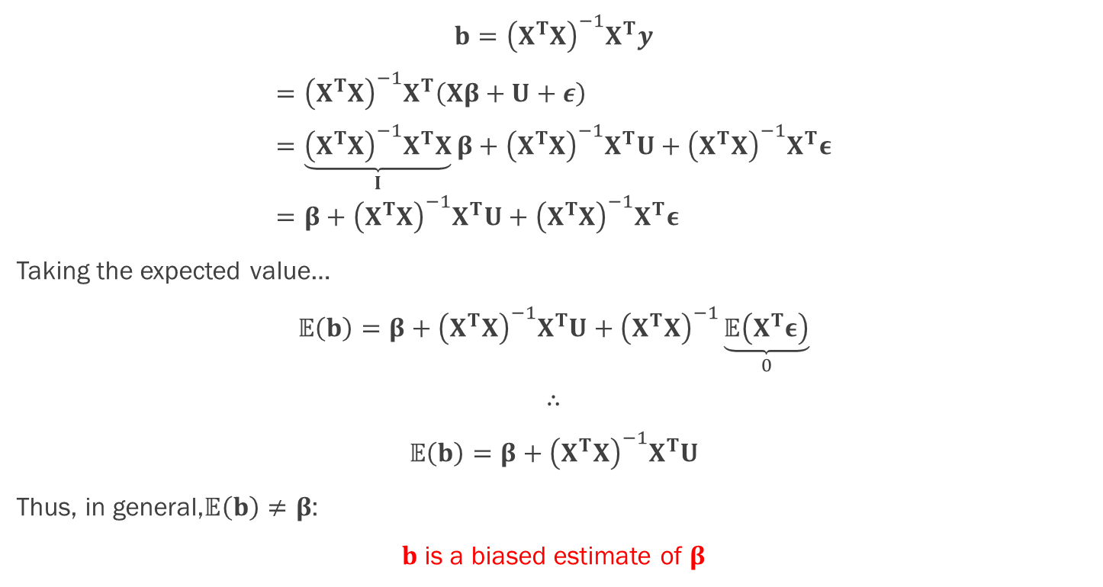
Ignoring a relevant variable typically leads to biased estimates of the coefficients…
$$b={\left(X^{T}X\right)}^{−1}X^{T}y$$
$$={\left(X^{T}X\right)}^{−1}X^{T}\left(Xβ+U+ε\right) \\ =\underset{I}{\underbrace{{\left(X^{T}X\right)}^{−1}X^{T}X}}β+{\left(X^{T}X\right)}^{−1}X^{T}U+{\left(X^{T}X\right)}^{−1}X^{T}ε \\ =β+{\left(X^{T}X\right)}^{−1}X^{T}U+{\left(X^{T}X\right)}^{−1}X^{T}ε$$
Taking the expected value…
$$𝔼\left(b\right)=β+{\left(X^{T}X\right)}^{−1}X^{T}U+{\left(X^{T}X\right)}^{−1}\underset{0}{\underbrace{𝔼\left(X^{T}ε\right)}}$$
$$∴$$
$$𝔼\left(b\right)=β+{\left(X^{T}X\right)}^{−1}X^{T}U$$
Thus, in general,$𝔼\left(b\right)≠β$:
$b$ is a biased estimate of $β$

Slide 12
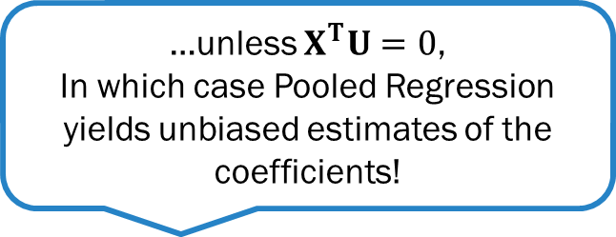
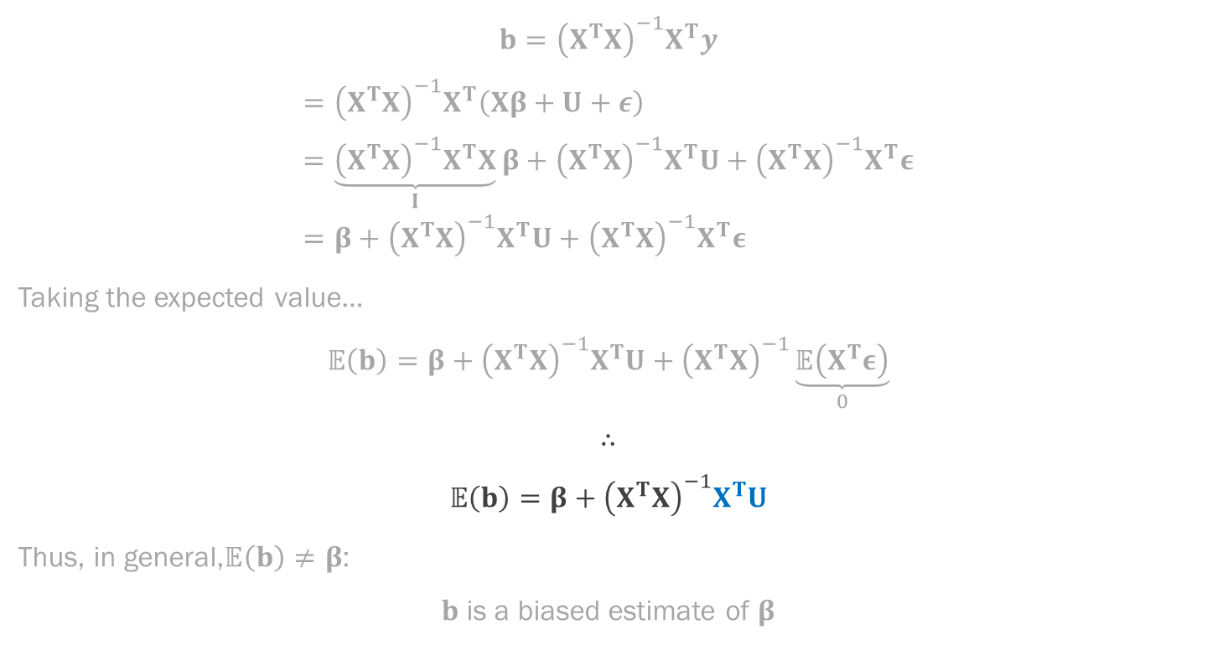
Ignoring a relevant variable typically leads to biased estimates of the coefficients…
$$b={\left(X^{T}X\right)}^{−1}X^{T}y$$
$$={\left(X^{T}X\right)}^{−1}X^{T}\left(Xβ+U+ε\right) \\ =\underset{I}{\underbrace{{\left(X^{T}X\right)}^{−1}X^{T}X}}β+{\left(X^{T}X\right)}^{−1}X^{T}U+{\left(X^{T}X\right)}^{−1}X^{T}ε \\ =β+{\left(X^{T}X\right)}^{−1}X^{T}U+{\left(X^{T}X\right)}^{−1}X^{T}ε$$
Taking the expected value…
$$𝔼\left(b\right)=β+{\left(X^{T}X\right)}^{−1}X^{T}U+{\left(X^{T}X\right)}^{−1}\underset{0}{\underbrace{𝔼\left(X^{T}ε\right)}}$$
$$∴$$
$$𝔼\left(b\right)=β+{\left(X^{T}X\right)}^{−1}X^{T}U$$
Thus, in general,$𝔼\left(b\right)≠β$:
$b$ is a biased estimate of $β$
…unless $X^{T}U=0$,
In which case Pooled Regression yields unbiased estimates of the coefficients!

Slide 13


What does $$X^{T}U=0$$ mean in practice?

Slide 14


It means that the Unobserved variables ($U$) are unrelated to the observed characteristics of the entities ($X$)

Slide 15
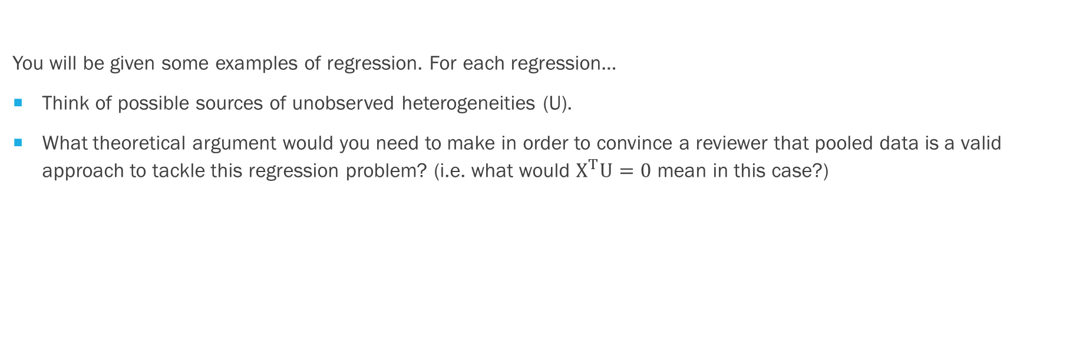
Exercise
You will be given some examples of regression. For each regression…
Think of possible sources of unobserved heterogeneities (U).
What theoretical argument would you need to make in order to convince a reviewer that pooled data is a valid approach to tackle this regression problem? (i.e. what would $X^{T}U=0$ mean in this case?)

Slide 16
Exercise
Child Mortality ~ Democracy
Spending ~ Income
Wages ~ Education level
Crime Rate ~ Unemployment

Slide 17


$X^{T}U=0$ means coefficients are unbiased, but this does not mean Pooled regression works perfectly $…$

Slide 18
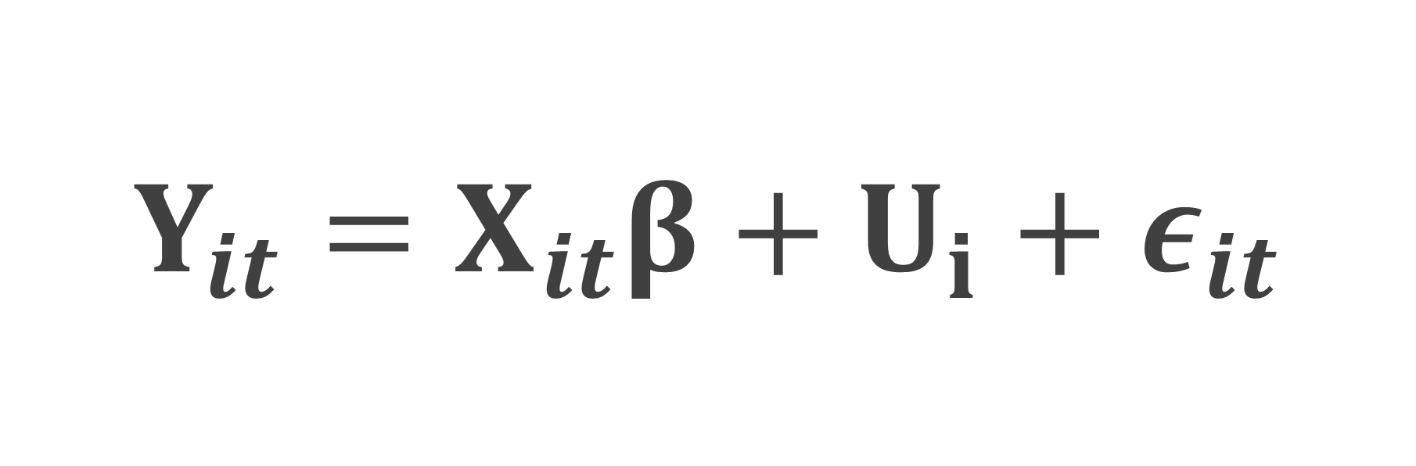
$$Y_{it}=X_{it}β+U_{i}+ε_{it}$$
Ignored in pooled regression

Slide 19
$$Y_{it}=X_{it}β+U_{i}+ε_{it}$$
Pooled regression’s residual

Slide 20
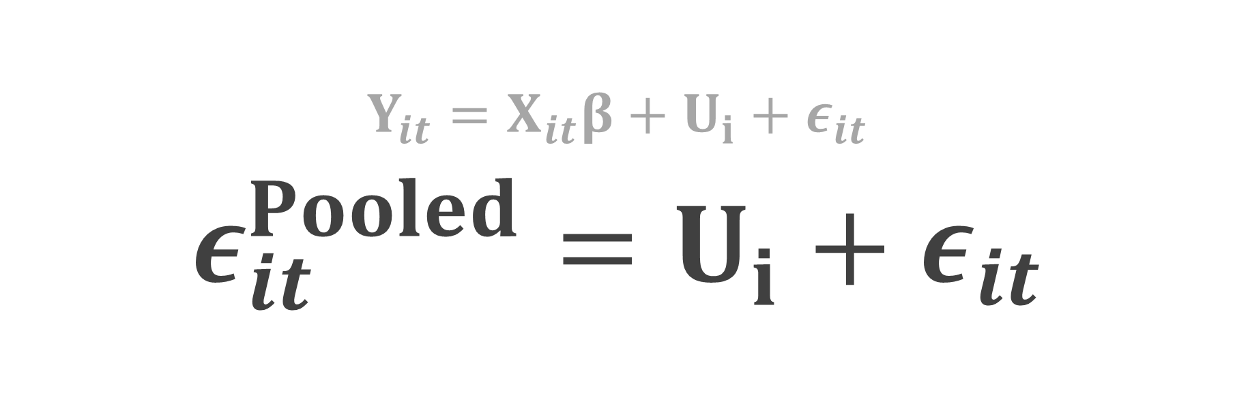
$$Y_{it}=X_{it}β+U_{i}+ε_{it}$$
$$ε_{it}^{Pooled}=U_{i}+ε_{it}$$

Slide 21
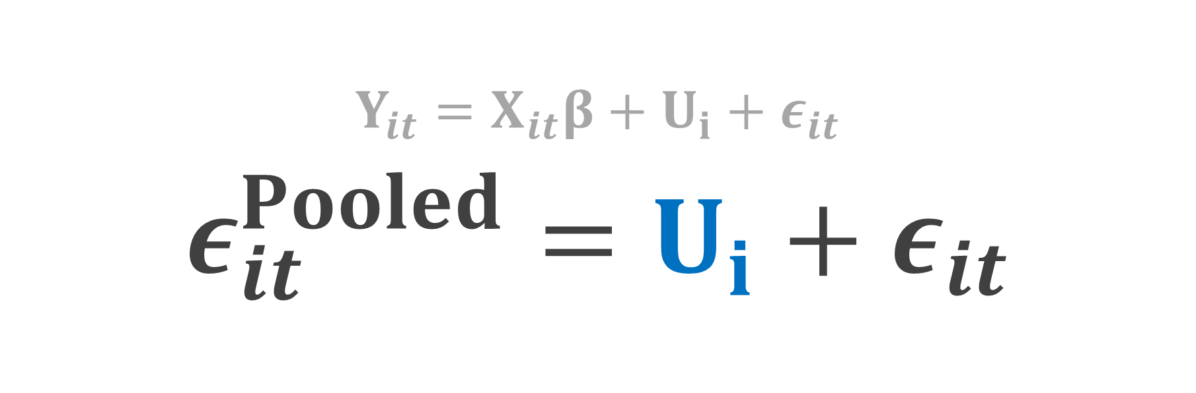
$$Y_{it}=X_{it}β+U_{i}+ε_{it}$$
$$ε_{it}^{Pooled}=U_{i}+ε_{it}$$
Residuals are serially correlated

Slide 22
OK, so can I use pooled regression?

Slide 23
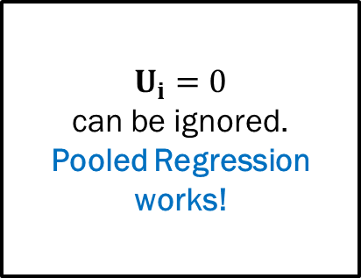
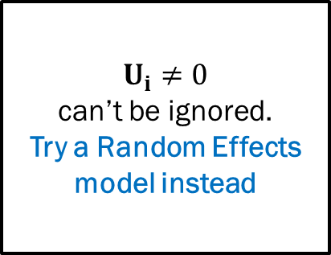
Breusch-PagaN lagrange multipliers test
Are residuals independent?
Yes
No
$$U_{i}=0$$
can be ignored.
Pooled Regression works!
$$U_{i}≠0$$
can’t be ignored.
Try a Random Effects model instead

Slide 24
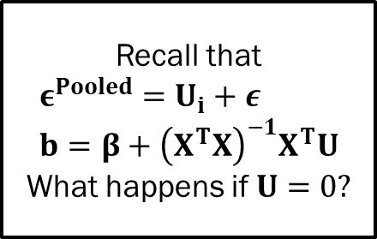
Breusch-PagaN lagrange multipliers test
Recall that
$$ε^{Pooled}=U_{i}+ε \\ b=β+{\left(X^{T}X\right)}^{−1}X^{T}U$$
What happens if $U=0?$
Are residuals independent?
Yes
No
$$U_{i}=0$$
can be ignored.
Pooled Regression works!
$$U_{i}≠0$$
can’t be ignored.
Try a Random Effects model instead

Slide 25
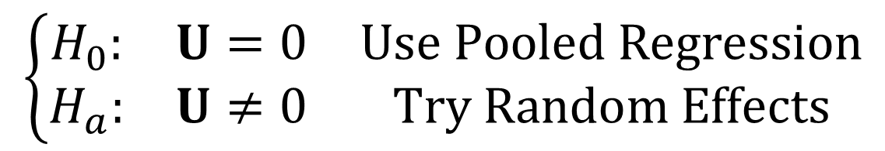
Breusch-PagaN lagrange multipliers test
$$\left\{\begin{matrix}H_{0}: & U=0 & Use Pooled Regression \\ H_{a}: & U≠0 & Try Random Effects\end{matrix}\right.$$

Slide 26

How about an example?

Slide 27
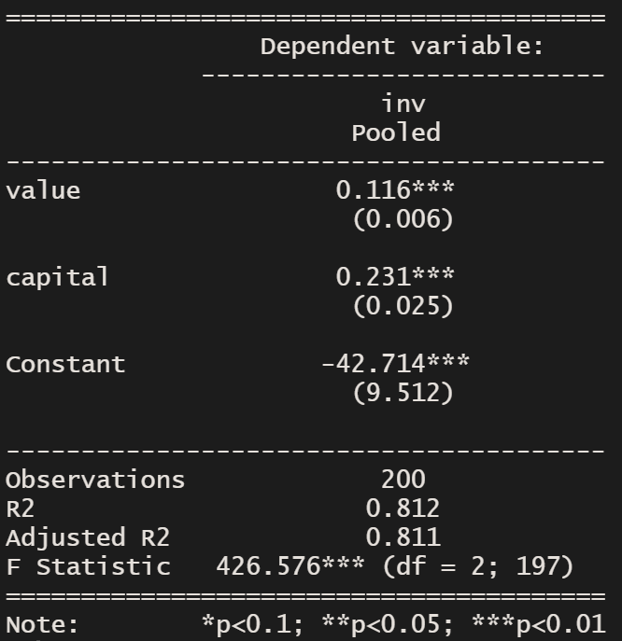
Is investment determined by company value? The Grunfeld dataset
library("plm")
library("stargazer")
pooled <- plm(inv ~ value + capital, data=Grunfeld, model='pooling')
Notes:
A brilliant young econometrician who earned his bachelor from the Hebrew University in Jeursalem and his PhD from Chicago.
Died at the age of 30, drowned.

Slide 28


What if we try to capture $U_{i}$ by using a dummy for each$i$?

Slide 29
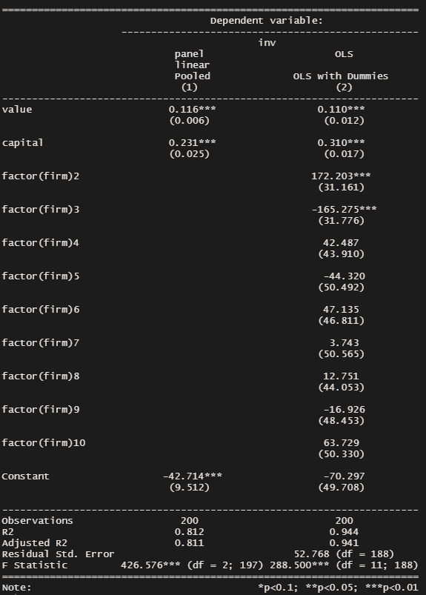
Is investment determined by company value? The Grunfeld dataset
library("plm")
library("stargazer")
pooled <- plm(inv ~ value + capital, data=Grunfeld, model='pooling’)
ols <- lm(inv~value + capital + factor(firm, data=Grunfeld)
Notes:
Note significant dummies. This suggests Ui cannot be ignored. So pooled model is not adequate here. Indeed, note changes in the coefficients of the variables, especially capital, suggesting bias in the estimation due to E(Ui|X) != 0. Using dummies to model Ui works – but we have better
ways of doing this. In fact, the Fixed Effects models gives us exactly the same result with much less computational effort and without needing the dummies.

Slide 30
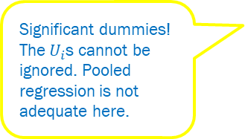
Is investment determined by company value? The Grunfeld dataset
library("plm")
library("stargazer")
pooled <- plm(inv ~ value + capital, data=Grunfeld, model='pooling’)
ols <- lm(inv~value + capital + factor(firm, data=Grunfeld)
.
Significant dummies! The$U_{i}$s cannot be ignored. Pooled regression is not adequate here.
Notes:
Note significant dummies. This suggests Ui cannot be ignored. So pooled model is not adequate here. Indeed, note changes in the coefficients of the variables, especially capital, suggesting bias in the estimation due to E(Ui|X) != 0. Using dummies to model Ui works – but we have better
ways of doing this. In fact, the Fixed Effects models gives us exactly the same result with much less computational effort and without needing the dummies.

Slide 31
Is investment determined by company value? The Grunfeld dataset
library("plm")
library("stargazer")
pooled <- plm(inv ~ value + capital, data=Grunfeld, model='pooling’)
ols <- lm(inv~value + capital + factor(firm, data=Grunfeld)
.
Coefficients changed.
Pooled Regression estimates were biased!
Notes:
Note significant dummies. This suggests Ui cannot be ignored. So pooled model is not adequate here. Indeed, note changes in the coefficients of the variables, especially capital, suggesting bias in the estimation due to E(Ui|X) != 0. Using dummies to model Ui works – but we have better
ways of doing this. In fact, the Fixed Effects models gives us exactly the same result with much less computational effort and without needing the dummies.

Slide 32
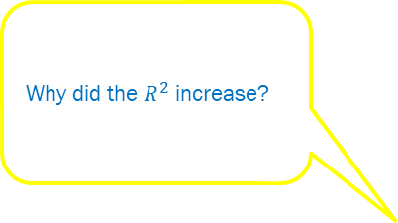
Is investment determined by company value? The Grunfeld dataset
library("plm")
library("stargazer")
pooled <- plm(inv ~ value + capital, data=Grunfeld, model='pooling’)
ols <- lm(inv~value + capital + factor(firm, data=Grunfeld)
.
Why did the $R^{2}$ increase?
Notes:
Note significant dummies. This suggests Ui cannot be ignored. So pooled model is not adequate here. Indeed, note changes in the coefficients of the variables, especially capital, suggesting bias in the estimation due to E(Ui|X) != 0. Using dummies to model Ui works – but we have better
ways of doing this. In fact, the Fixed Effects models gives us exactly the same result with much less computational effort and without needing the dummies.

Slide 33
Is investment determined by company value? The Grunfeld dataset
library("plm")
library("stargazer")
pooled <- plm(inv ~ value + capital, data=Grunfeld, model='pooling’)
ols <- lm(inv~value + capital + factor(firm), data=Grunfeld)
.
I’m not interested in all these dummy coefficients. They only make my model look more complex! (continues….)
Notes:
Note significant dummies. This suggests Ui cannot be ignored. So pooled model is not adequate here. Indeed, note changes in the coefficients of the variables, especially capital, suggesting bias in the estimation due to E(Ui|X) != 0. Using dummies to model Ui works – but we have better
ways of doing this. In fact, the Fixed Effects models gives us exactly the same result with much less computational effort and without needing the dummies.

Slide 34
Is investment determined by company value? The Grunfeld dataset
library("plm")
library("stargazer")
pooled <- plm(inv ~ value + capital, data=Grunfeld, model='pooling’)
ols <- lm(inv~value + capital + factor(firm, data=Grunfeld)
.
Can’t I have a model that looks like this, simple, only with the coefficients I’m interested in…. But unbiased???
Notes:
Note significant dummies. This suggests Ui cannot be ignored. So pooled model is not adequate here. Indeed, note changes in the coefficients of the variables, especially capital, suggesting bias in the estimation due to E(Ui|X) != 0. Using dummies to model Ui works – but we have better
ways of doing this. In fact, the Fixed Effects models gives us exactly the same result with much less computational effort and without needing the dummies.

Slide 35

Yes, of course!

Slide 36

It’s called fixed effects

Slide 37

Stay tuned…

